Slide 1
Modeling Industrial and Cultural Heritage Data
Nishara Pathirana

Slide 2
Summary
Introduction
Data in Hand
Goal of the Lab
Organizing Big Data using the Data Lake
A Metadata Model
An Ontology Based Data Retrieval

Slide 3
Introduction
Section 1

Slide 4
Industrial and Cultural Heritage Data
Very diverse and potentially big
Rate of data generation is very high
High % of these data are
Unstructured
Heterogeneous
Peta or Exabytes of data

Slide 5
Industrial and Cultural Heritage Data (2)
Data are in different formats
Text
Image
XML
Map
Video
Audio
Web Document etc.

Slide 6
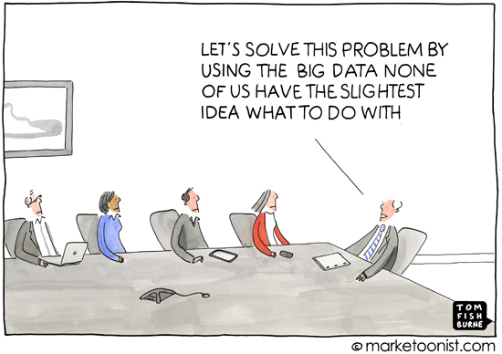
What we want?
We want to organize these data to be able to analyze it

Slide 7
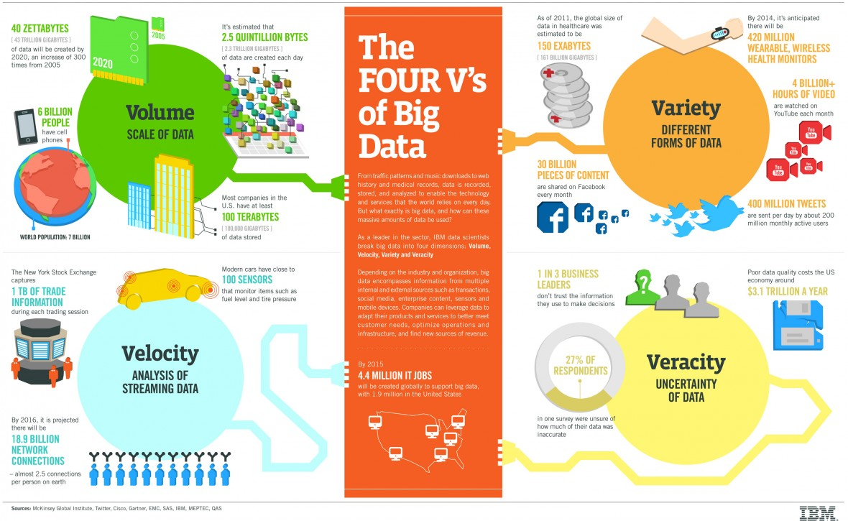
What is Big Data?

Slide 8
Data in Hand
Section 2

Slide 9
Textile/Cultural Heritage Data
From Lille Territory
 | Source
 | IRHiS (History Lab) | Inventory Services | La Voix Du Nord | MEL
Content Description | Images | Buildings/Inventories used for textile industry | News Articles related to textile industry | Cultural Heritage in Lille
Type and # of files | 30 xml files | 50 xml files | 1 xml file | 4 PDF documents
# of Instances | 30 | 50 | 31

Slide 10
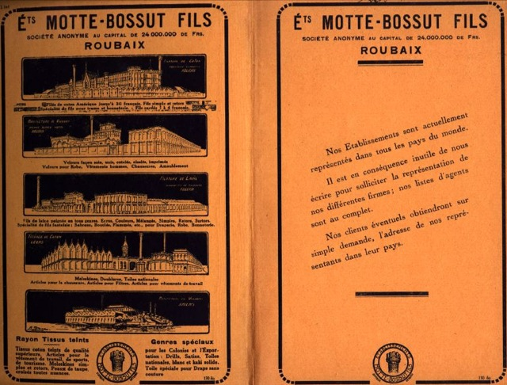
Images

Slide 11
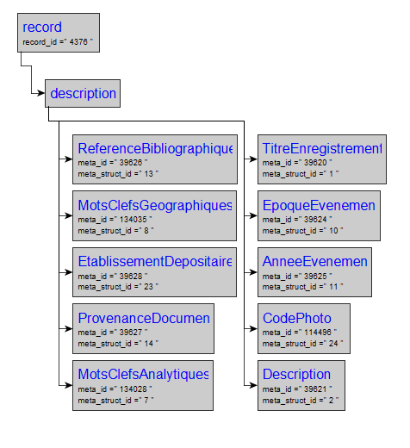
XML Structure of an Image Description

Slide 12
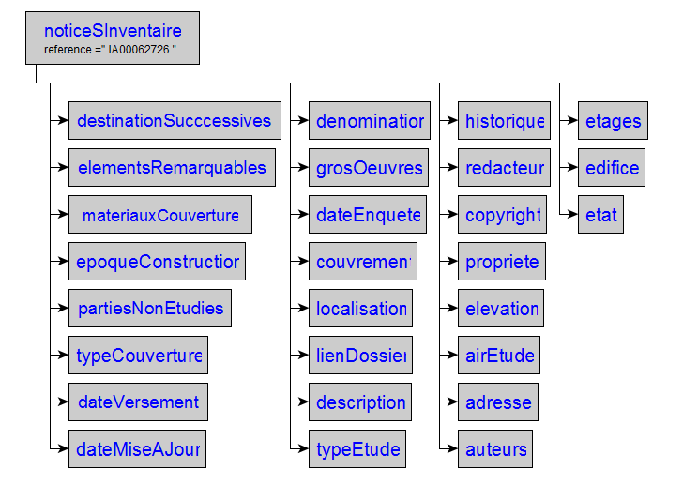
Inventories (XML Structure)

Slide 13
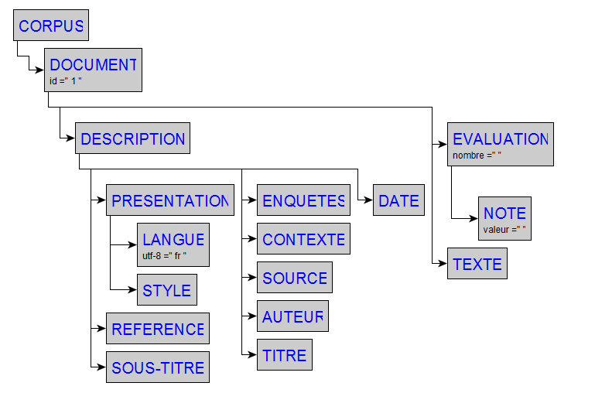
News Articles (XML Structure)

Slide 14
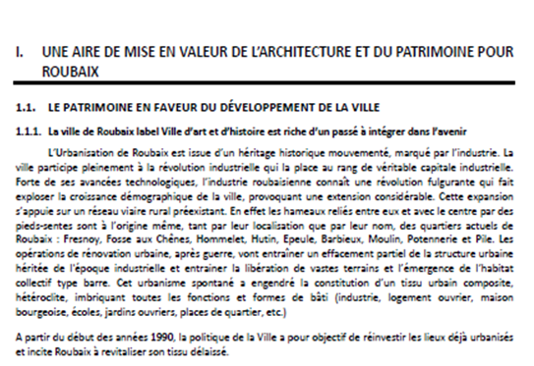
Text Documents (PDF files about MEL)

Slide 15
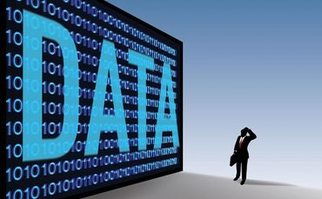
Goal of the Lab
Organizing Cultural and Textile Industry heritage data from Lille Territorial for analysis purposes
Information Broadcasting
Information Exchanging
Heritage Data Preservation

Slide 16
Organizing Big Data
Using the
Data Lake
Section 3

Slide 17
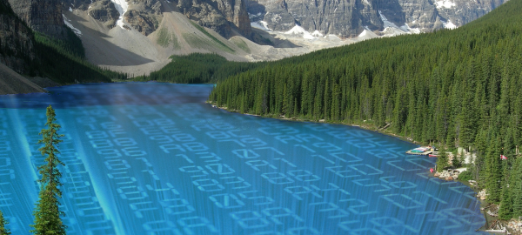
What is a Data Lake?
Data Lake is a large object-based storage where data are stored in its raw format
Data Lake accepts data from any source, in any format

Slide 18
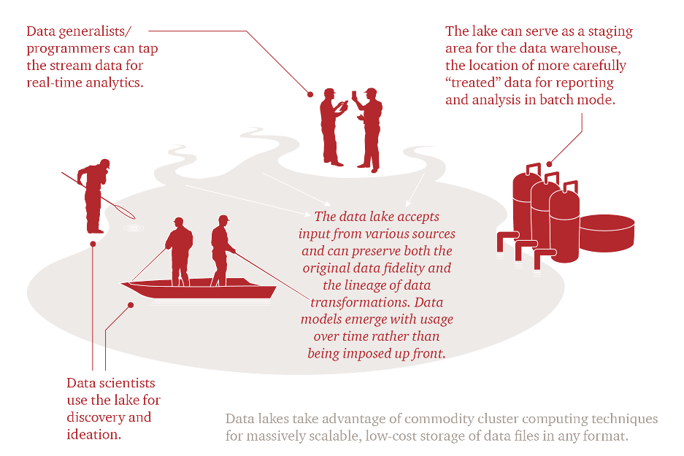
Data Lake is for Everyone…

Slide 19
Data Lake Vs Data Warehouse
Data Lake | Data Warehouse
Retains all data→ Extremely large data volumes (Petabytes) | Accepts data to some data aggregation level → Large (Terabytes)
Supports all data types | Generally consists of data extracted from transactional systems
Easily adapts to changes | Difficult to change the schema as it costs a lot
Scales horizontally | Scales vertically
Data focus is at time of use/search → schema on read | Data focus is at time of design → schema on write
Open for various questions | Designed for predefined questions

Slide 20
Towards a Smarter Data Lake

Slide 21
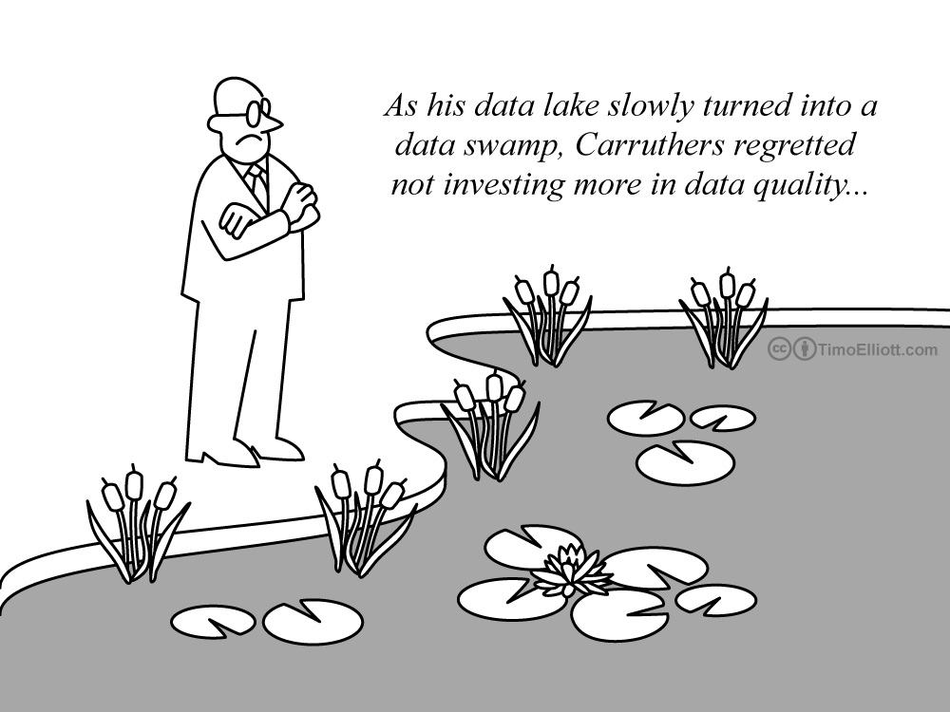
Ensuring Data Quality in a Lake

Slide 22
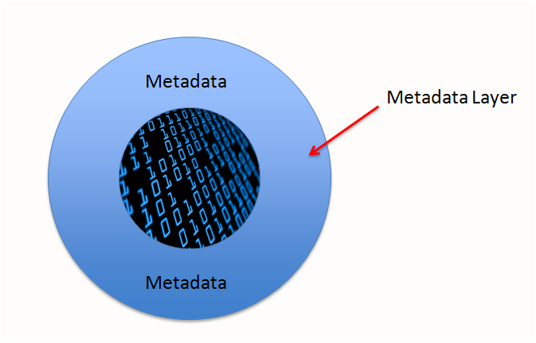
A Metadata Layer for the Lake
A data lake without an effective Metadata management layer is like a Ferrari without fuel
You are not going to go anywhere quickly without the essential ingredient to make it perform

Slide 23
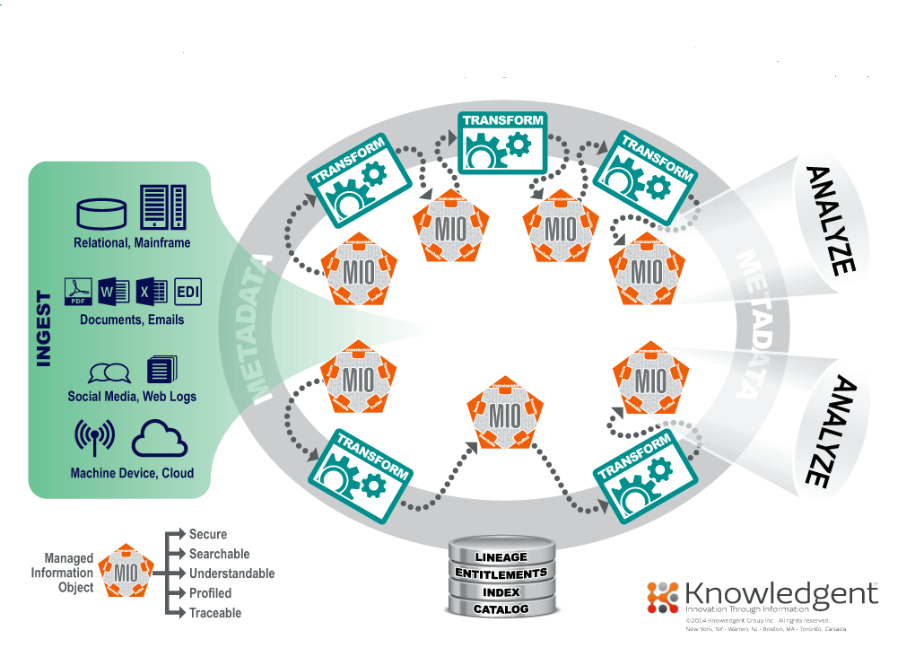
A Supervised Data Lake

Slide 24


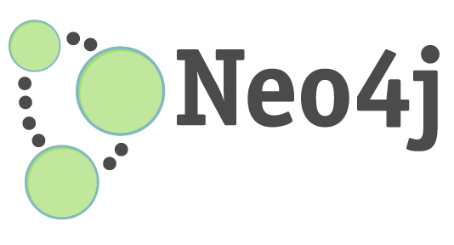
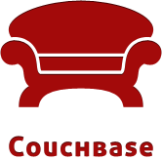

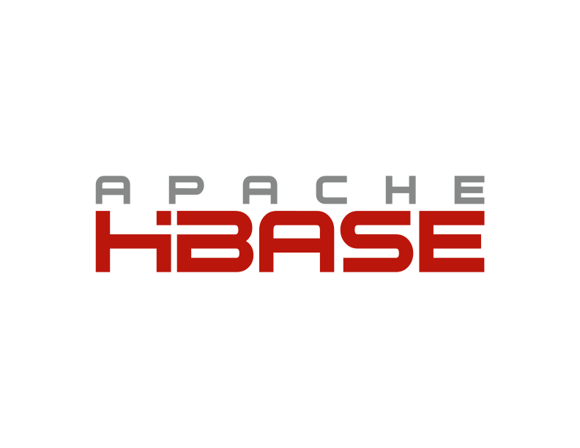


Data Lake Analytic Tools
NoSQL Databases
Parallel processing systems
Hadoop
Spark

Slide 25
A Metadata Model
For Our Data
Section 4

Slide 26

A Data Lake for Us
Metadata
Layer
Images
Inventories
News
MEL Texts

Slide 27
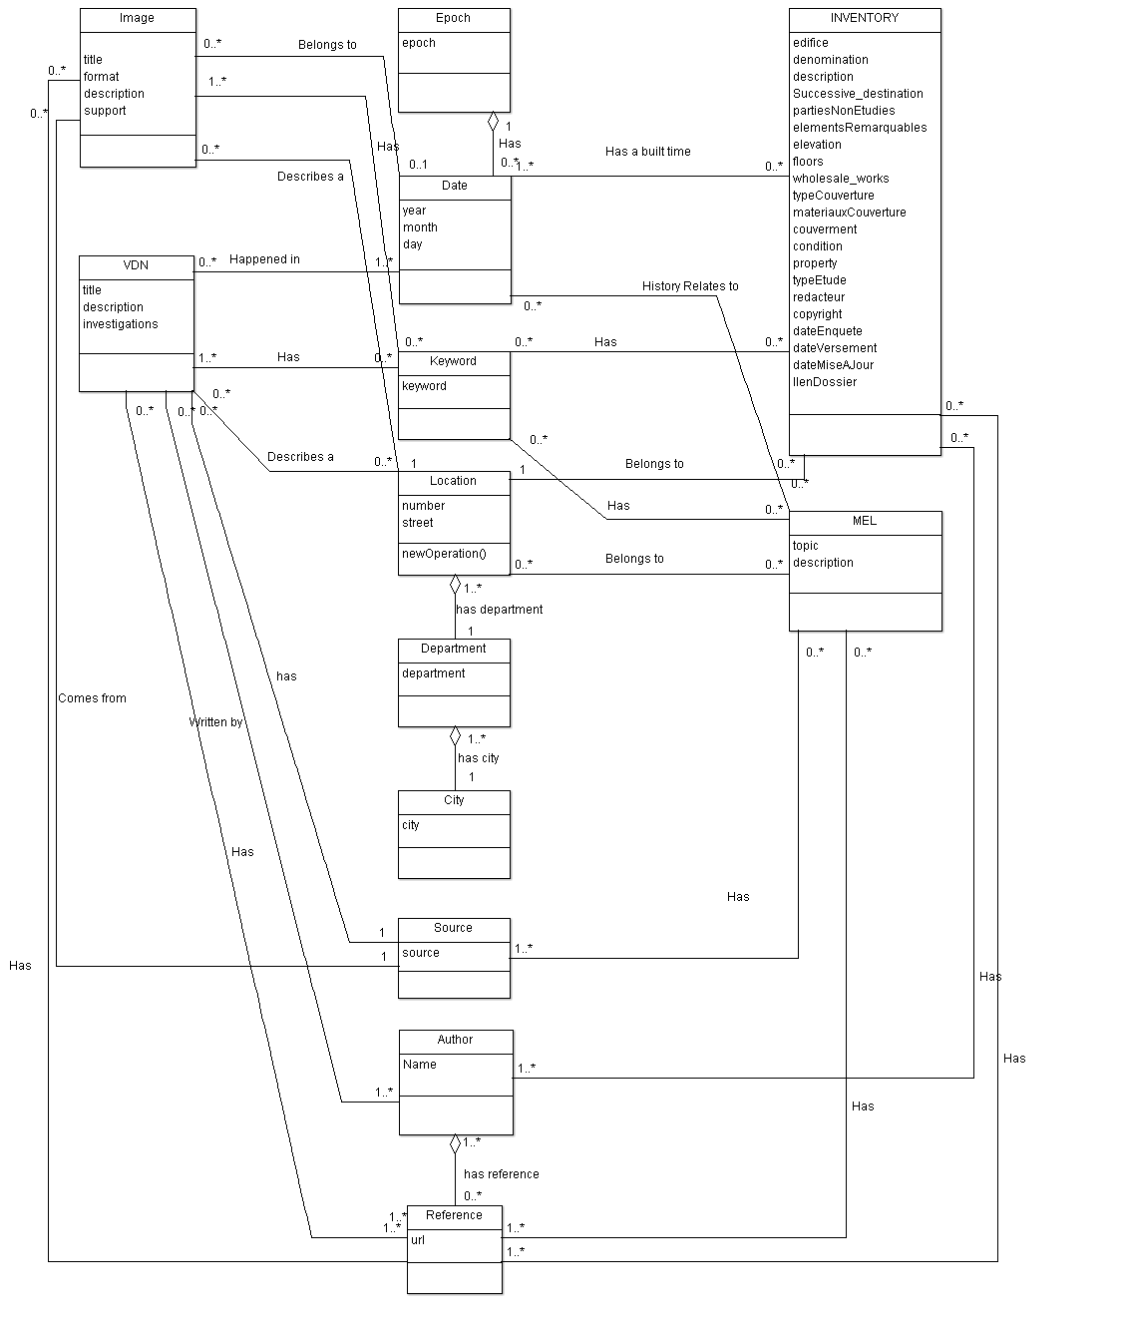

Slide 28
An Ontology approach for Data Retrieval
Section 5

Slide 29
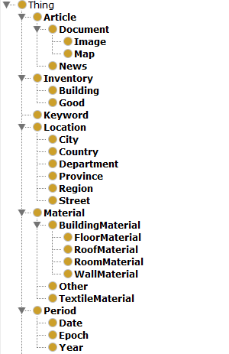
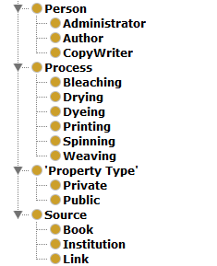
The Class Hierarchy for Textile Industry Heritage

Slide 30
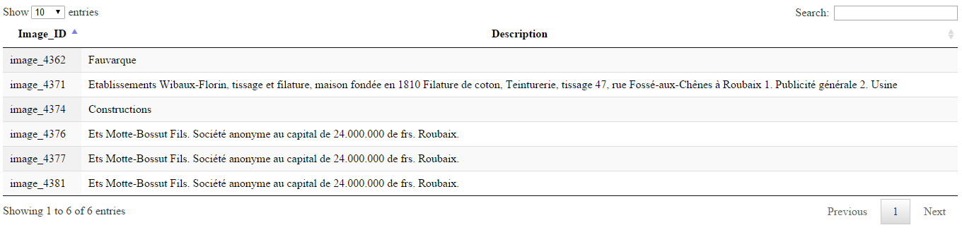
Querying
PREFIX onto: <http://url_to_tectoniq/tectoniq#>
SELECT ?name ?description
WHERE {
?name onto:hasDescription ?description
}

Slide 31
Discussion
The goals of data analysis?
Notes:
Make some more points.

Slide 32
Thank You!

